Slide 1
Concepts of Object Oriented Programming

Slide 2
Programming Paradigm
Procedure oriented programming paradigm
Object oriented programming paradigm
Advantages of OOPs
Basic concepts of OOPs

Slide 3
Programming paradigm

Slide 4
Programming paradigm
Def : Programming paradigm are a way to classify programming languages according to the style of computer programming
Some paradigm gives more important to the procedure, others gives more important to the data
The term paradigm used for reduce the complexity of the programming language

Slide 5
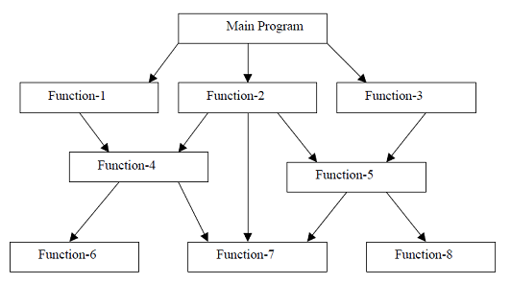
Procedure oriented Programming paradigm
It specifies a series of well structured steps and procedure to compose a program
It contain a systematic order
Also called top-down language

Slide 6
Complex type programming paradigm
For reduce complexity : use functions and modules
Eg : C, Pascal, Basic, Fortran

Slide 7
Reason for increase the complexity
Give important to procedure than data
to add a new data item, should rewrite the program
Create a new data-type is difficult (no user defined datatype)
Data and functions are treated as separately
Data
Function

Slide 8
Object oriented Programming paradigm
It eliminate the drawback of POP Paradigm
Bottom to up
Data and functions are treated as a single unit
Data
Function
Object

Slide 9
Advantages of OOPs
Modularity (divide Large program by module)
Allow data abstraction (Hide / Protect data from user)
Good for defining abstract data-types
code re-usability
Real world data entities can easily created
Support to create new data-types (User defined)

Slide 10
Basic Concepts Of OOPs

Slide 11
Basic concepts of OOPs
Object
Class
Data Abstraction
Data Encapsulation
Modularity
Inheritance
Polymorphism

Slide 12
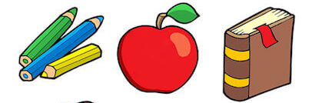
Object
Anything around us can be treated as an object
It have properties and behaviours
The object combines data and faction as a single unit
Properties
Behaviours
Data
Function
Real-world Object
OOP Object

Slide 13
The function inside the object is called member function
And data is called member
Object define inside the class
Data
Member
Function
Member Function
Object
Object

Slide 14



Classes
Class is a user defined data type
Class is collection of objects with similar attributes(properties)
Class declare using the keyword “class”
Class is a blueprint of objects

Slide 15
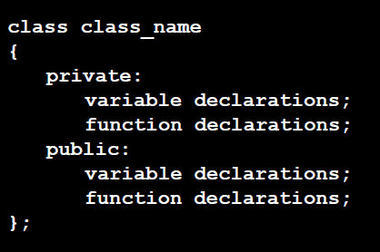
Syntax

Slide 16
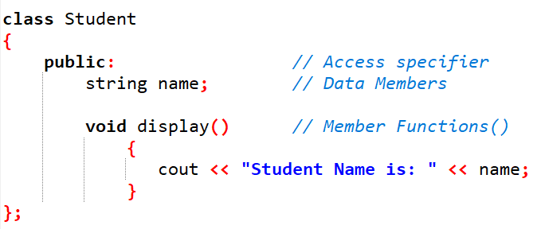
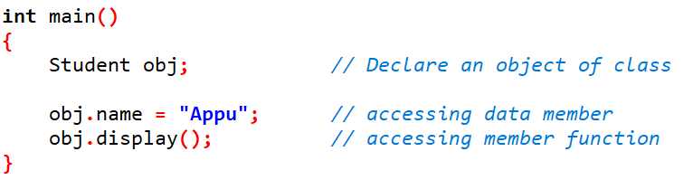

Slide 17
Data Abstraction
It is an essential features of OOP
Hiding details from out standers
It gives the output without showing the details
Public : visible in main function (not hide)
Private : only visible inside the class (hide)
Protected : only visible in derived classes (hide)

Slide 18
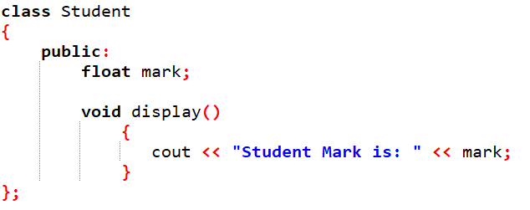
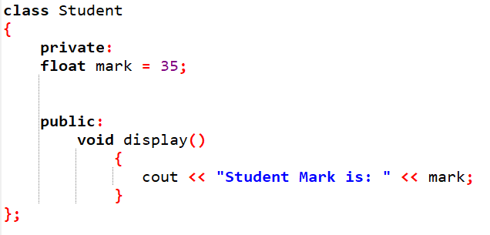

Slide 19
Data Encapsulation
Binding of data and functions together
Keeps both data and function safe from main program / outside interface
Private : only visible inside the class (hide)
Protected : only visible in derived classes (hide)

Slide 20
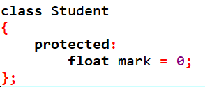
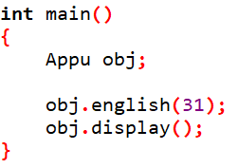
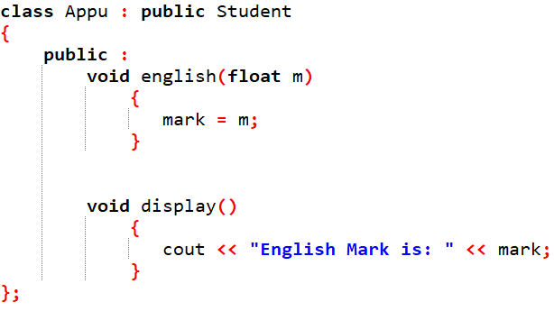

Slide 21
Modularity
All programs are written / divide into modules
It reduce the complexity of program
And each module can be used for another project (code re-usability)
Each module execute when call the module using function name

Slide 22
Main ()
20 line program set
10 line program set
Main()
Total = 95 line program
50 line program set
5 line program set
10 line program set

Slide 23
Module 3
Module 1
Module 4
Module 5
Main ()
Module 1
Module 2
Module 3
Module 4
Module 5
Module 2

Slide 24
Module 3
Module 1
Module 4
Module 5
Main ()
Module 1
Module 5
Module 1
Module 4
Module 1
Module 2

Slide 25
Inheritance
One class derived from another one
One class showing the property of another class
Single Inheritance
Multiple Inheritance
Hierarchical Inheritance
Multilevel Inheritance
Hybrid Inheritance

Slide 26
Single Inheritance
Class A
Base Class / Parent class
Class B
Derived Class / Child class

Slide 27
Multiple Inheritance
Base Class
Base Class
Class A
Class B
Class C
Derived class A & B

Slide 28
Hierarchical Inheritance
Base class
Class A
Class B
Class C
Class D
Derived class of A
Derived class of A
Derived class of A

Slide 29
Multilevel Inheritance
Class A
Base class of B
Class B
Derived class of A
Base class of C
Class C
Derived class of B

Slide 30
Hierarchical Inheritance
Base class of B & D
Class A
Derived class of A
Base class of C
Derived class of A
Base class of C
Class B
Class D
Class C
Derived class of B & D

Slide 31
Polymorphism
One function or operator or any other symbols can be used for different use called polymorphism
Operator overloading
One operator is used for more than one operation is known as operator overloading
Ex : + ( 4 + 6 ) “hello” + “world”
Function overloading
One Function name is used for more than one functions is known as function overloading

Slide 32
